Slide 1
Rear End Collision Sensor
By Hannah Schiffmacher

Slide 2
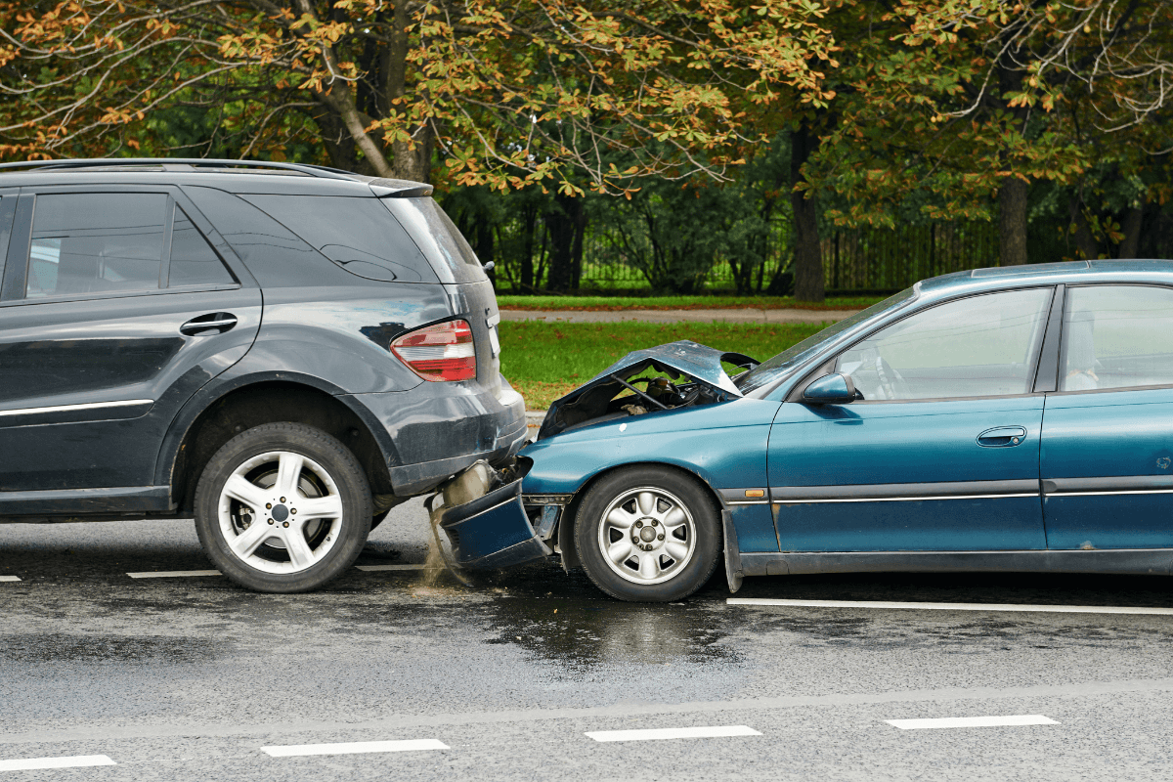
Problem Statement
Technology is always being introduced to make driving safer
Many rear-end collisions due to drivers not paying attention or icy roads
The sensor will detect incoming cars and tailgating

Slide 3


Phase 1
Created code skeleton
Acquired hardware components

Slide 4
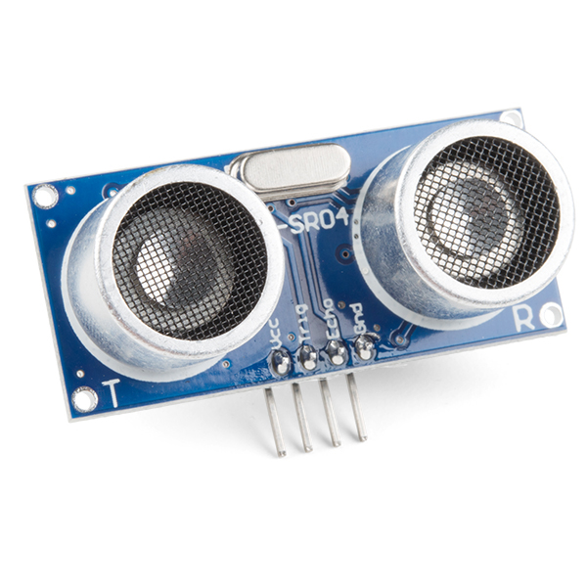
Phase 2
Tested each hardware component
Finished prototype

Slide 5
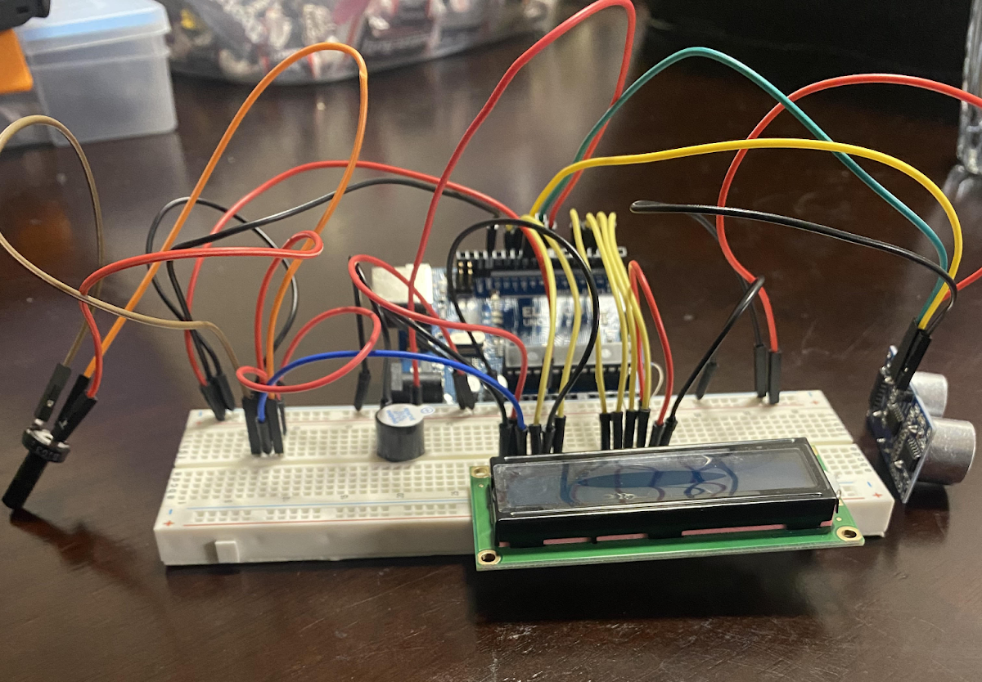
Phase 3
Finalized software
Retested hardware

Slide 6
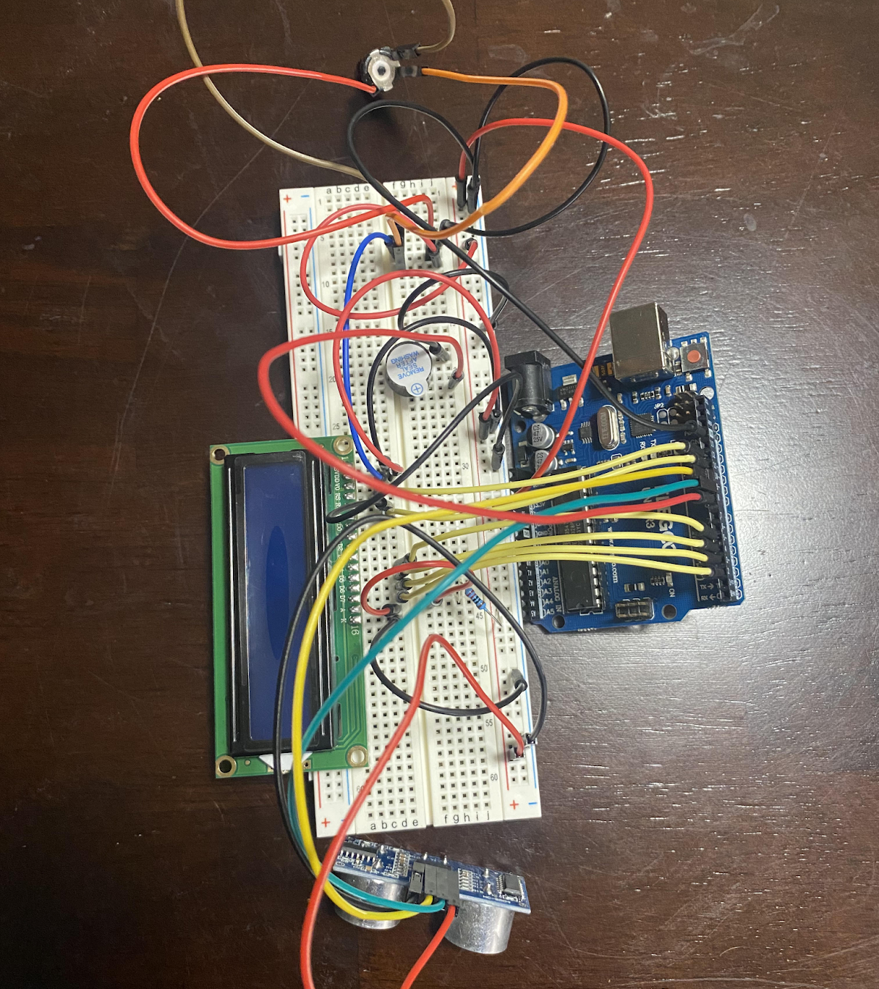
Hardware
Elegoo Uno R3
Ultrasonic Sensor
LCD Display
Potentiometer
Active Buzzer

Slide 7

Demo

Slide 8

What I Learned
How to set up and use Arduino hardware
Real-time Embedded Systems
How to use Arduino IDE

Slide 9
Q&A

Slide 10
References
LCD Libraries and Set-Up: https://docs.arduino.cc/learn/electronics/lcd-displays
Ultrasonic Sensor Set-Up: https://howtomechatronics.com/tutorials/arduino/ultrasonic-sensor-hc-sr04/
Active Buzzer: https://www.youtube.com/watch?v=gj-H_agfd6U
Images
https://curtislegalgroup.com/news/who-is-at-fault-in-a-rear-end-accident/
https://github.com/arduino
https://store-usa.arduino.cc/products/arduino-uno-rev3
https://www.sparkfun.com/products/15569

